Slide 1



BANGALORE INSTITUTE OF TECHNOLOGY
DEPARTMENT OF ELECTRONICS AND COMMUNICATION ENGINEERING
PROJECT PHASE – II PRESENTATION
“DESIGN AND IMPLEMENTATION OF HIGH SPEED SRAM CELL”
Under the guidance of:
Presented by:
Dr. Vijayaprakash A M
PROFESSOR
ECE
Pavan Kumar S
1BI20EC088
Sandesh G Naik
1BI20EC127
Spandana N D
1BI20EC148
Yamuna A R
1BI20EC176

Slide 2
BANGALORE INSTITUTE OF TECHNOLOGY
Institute Vision and Mission
Vision:
To Establish and Develop the Institute as a centre of higher learning, ever abreast with expanding horizon of knowledge in the field of Engineering and Technology, with Entrepreneurial thinking, Leadership Excellence for life-long success and solve societal problem.
Mission :
Provide high quality education in the Engineering disciplines from the undergraduate through doctoral levels with creative academic and professional programs.
Develop the Institute as a leader in Science, Engineering, Technology and management, Research and apply knowledge for the benefit of society.
Establish mutual beneficial partnerships with industry, alumni, local, state and
central governments by public service assistance and collaborative research.
Inculcate personality development through sports, cultural and extracurricular activities and engage in the social, economic and professional challenges.
DEPARTMENT OF ELECTRONICS AND COMMUNICATION ENGINEERING

Slide 3
BANGALORE INSTITUTE OF TECHNOLOGY
Department Vision and Mission
Vision
Imparting Quality Education to achieve Academic Excellence in Electronics and Communication Engineering for Global Competent Engineers.
Mission
Create state of art infrastructure for quality education.
Nurture innovative concepts and problem solving skills.
Delivering Professional Engineers to meet the societal needs.
PEOs
PE01: Prepare graduates to be professionals, Practicing engineers and entrepreneurs in the field of Electronics and communication Engineering.
PE02: To acquire sufficient knowledge base for innovative techniques in design and Development of systems and tools.
PE03: Capable of competing globally in multidisciplinary field.
PE04: Achieve professional and personal success with awareness and commitment to ethical and social responsibilities as an individual as well as a team.
PE05: Graduates will maintain and improve technical competence through Continuous learning process.
DEPARTMENT OF ELECTRONICS AND COMMUNICATION ENGINEERING

Slide 4
BANGALORE INSTITUTE OF TECHNOLOGY
Department Vision and Mission
PSOs
PSO1: The graduates will be able to apply the principles of Electronics and Communication in core areas.
PSO2: An ability to use latest hardware and software tools in Electronics and Communication engineering.
PSO3: Preparing Graduates to satisfy industrial needs and pursue higher
studies with social-awareness and universal moral values.
DEPARTMENT OF ELECTRONICS AND COMMUNICATION ENGINEERING

Slide 5
BANGALORE INSTITUTE OF TECHNOLOGY
AGENDA
Abstract
Introduction
Literature Survey
Overview Of Literature Survey
Problem Statement
Objectives
Methodology
Implementation and design
Result and Discussion
Conclusion
References
DEPARTMENT OF ELECTRONICS AND COMMUNICATION ENGINEERING

Slide 6
BANGALORE INSTITUTE OF TECHNOLOGY
ABSTRACT
High speed and low power consumption have been the primary design goals for Static Random Access Memory (SRAM), but with technology scaling, we are now encountering new challenges. The stability and speed of SRAM are important issues to improve efficiency and performance of the system. This proposed work presents design and implementation of 1Kb 6T SRAM using CMOS technologies by using EDA tool. In this proposed work, SRAM cell is operated in 1V voltage. Our proposed high speed 6T SRAM cell has achieved read and write delay of 29.4ps & 15ps respectively which is comparatively less than previously published. And also our designed cell has read and write stability of 70 mV & 195 mV respectively.
DEPARTMENT OF ELECTRONICS AND COMMUNICATION ENGINEERING

Slide 7
BANGALORE INSTITUTE OF TECHNOLOGY
INTRODUCTION
Memory Arrays are classified into Random Access Memory and Serial Access Memory, In which Static RAM is Volatile memory.
Since SRAM is a volatile memory, offers an advantage over non-volatile DRAM memory which is slower and requires periodic refresh cycles.
This makes SRAM cells a fundamental building block of modern computing systems and a key technology for achieving high-speed data processing.
SRAM is mainly used for the cache memory in microprocessors, mainframe computers, engineering workstations due to high speed and low power consumption.
As we move down the hierarchy, capacity increases significantly (DRAM), but speed decreases.
Other memory technologies like DRAM offer better cost-effectiveness for larger capacity needs, while SRAM excels in speed-critical applications.
SRAM is used as Cache memory which is very fast and used to speed up the task of processor and memory interface.

Slide 8
BANGALORE INSTITUTE OF TECHNOLOGY
LITERATURE SURVEY
SL. No | Title | Author | Year of Publication | Methodology | Inference
1 | Analysis of Power, Delay and SNM of 6T & 8T SRAM Cells. | Vibhash Choudhary, Dharmendra Singh Yadav | 2022 IEEE | The variation of average power consumption and delay has been observed as an operation of the supply voltage | Results can vary depending on the chosen CMOS process technology (e.g., 45nm vs. 130nm). The paper might not address this dependence.
2 | An analytical access time model for on-chip cache memories | T. Wada, S. Rajan, and S. Przybylski | 2019 IEEE | Considered configuration, organization, and process parameters for formulation of the access time of on chip cache | It doesn’t consider interconnect delays and tag paths, for each delay stage it assumes a step input waveform, and overgeneralized delay models and circuit models.
DEPARTMENT OF ELECTRONICS AND COMMUNICATION ENGINEERING

Slide 9
BANGALORE INSTITUTE OF TECHNOLOGY
3 | Static Noise Margin Analysis of SRAM Cell For High Speed Application | Debasis Mukherjee, Hemanta Kr.Mondal | 2021 IJCSI | The butterfly method to calculate static noise margin, write noise margin and read noise margin of a 6T SRAM cell | Primary issues like poor stability, process variation tolerance in SRAM designs.
4 | Ultra Low Power SRAM Cell for High Speed Application using 90nm CMOS Technology | Hansraj, Ajay Rana | 2020 | Improved charging and discharging times for higher operating frequencies | Does not provide specific details about the read and write access times and area overhead due to an increase in the number of transistors.
DEPARTMENT OF ELECTRONICS AND COMMUNICATION ENGINEERING

Slide 10
BANGALORE INSTITUTE OF TECHNOLOGY
5 | Design and Analysis of Area and Power Optimised SRAM Cell for High-speed Processor | Govind Prasad, Bipin Chandra Mandi, Megha Jain | ICPC2T 2021 | Consideration of speed of read and write operation. | Lesser Stability.
6 | Design and analysis of 6T SRAM in 45 nm Technology | V. Panduranga Vemula, S. Priyanka, A. Sairam | IJERT 2022. | The design architecture is considered which shows speed improvements along with scaling of technology and delay time also decrease. | Fail to overcome primary issues like poor stability, process variation tolerance in SRAM designs.
DEPARTMENT OF ELECTRONICS AND COMMUNICATION ENGINEERING

Slide 11
BANGALORE INSTITUTE OF TECHNOLOGY
OVERVIEW OF LITERATURE SURVEY
From the above referred research paper there are few observation associated with Read and Write Stability, Read and Write Speeds, Design Complexity, Power Consumption, and Cost.
In the research paper we have found that read, write, hold, operations were performed for the 6T & 8T SRAM and the performance criteria were total stability & average delay.
The various design techniques are used to overcome factors like power dissipation, read and write delay, and stability.
After analyzing the required research papers, we found that the fast access time and low latency need to be upgraded so our main aim of this proposed work is to enhance the throughput with read and write speeds.
We have about to minimize access times to improve memory bandwidth and system performance by multi-threshold voltage (Vt) design techniques using advanced EDA tool.
Since in current day world speed seems to be a prominent while designing the integrated circuits with memories, if this not met slower SRAM can lead to reduced responsiveness in computing systems.
DEPARTMENT OF ELECTRONICS AND COMMUNICATION ENGINEERING

Slide 12
BANGALORE INSTITUTE OF TECHNOLOGY
PROBLEM STATEMENT
This proposed work focuses on designing and implementation of 1kb SRAM memory with operating voltage of 1V using CMOS technology. The circuit focuses on increasing the speed of the memory.
DEPARTMENT OF ELECTRONICS AND COMMUNICATION ENGINEERING

Slide 13
BANGALORE INSTITUTE OF TECHNOLOGY
OBJECTIVES
Design and implementation of Six Transistor SRAM memory cell.
Design and Implementation of peripherals like sense amplifier, pre-charge circuit, 32X32 cell array, row decoder and column decoder.
Implementation of 1Kb SRAM memory cell using those peripherals.
Stability analysis of SRAM cell SNM using Butterfly Curve and Analyzing the Waveform of 1 bit SRAM cell for delay calculation.
DEPARTMENT OF ELECTRONICS AND COMMUNICATION ENGINEERING

Slide 14
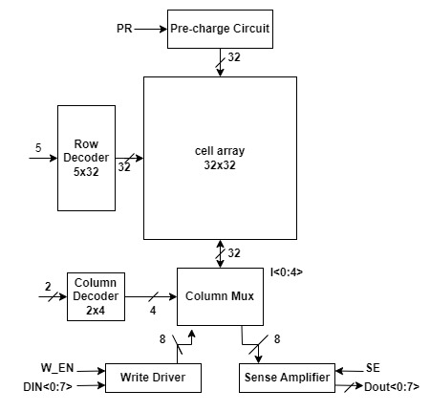
BANGALORE INSTITUTE OF TECHNOLOGY
Block Diagram of 1Kb SRAM Cell
Block diagram of 1Kb SRAM array consists of SRAM cell, write driver circuit, precharge circuit, sense amplifier ,row and column decoder.
Since the memory core trade performance and reliability in reduction area, memory design relies exceedingly on the peripheral circuitry to recover both speed and electrical integrity
For fast read and write operation separate write driver circuit and sense amplifier dedicated to each column.
DEPARTMENT OF ELECTRONICS AND COMMUNICATION ENGINEERING

Slide 15
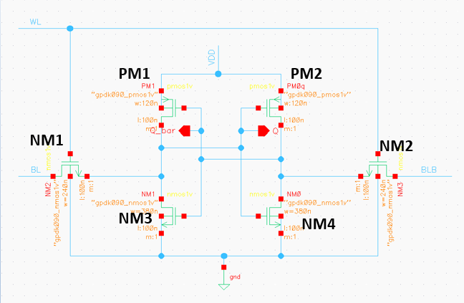
BANGALORE INSTITUTE OF TECHNOLOGY
PROPOSED METHODOLOGY
Six Transistor SRAM Cell
For the faster write operation, PMOS PM1 needs to be weaker than the access transistor NM1.
For faster read from the cell the driver NM3 must be stronger than the access transistor NM1
Use of wider access transistors helps for faster current flow during read/write access.
( W/L)pull-up < ( W/L)access << ( W/L) pull-down
DEPARTMENT OF ELECTRONICS AND COMMUNICATION ENGINEERING

Slide 16
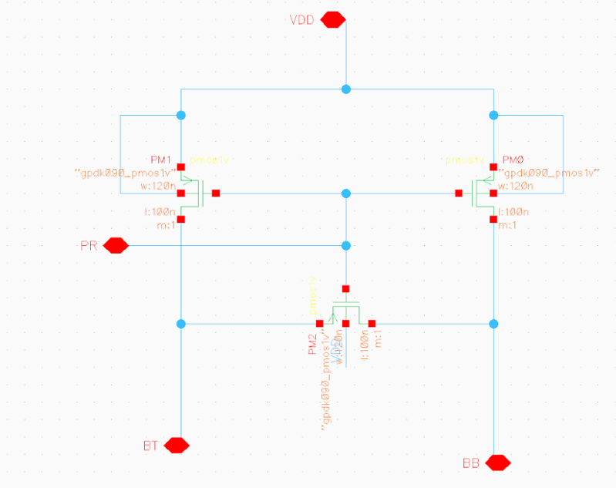
BANGALORE INSTITUTE OF TECHNOLOGY
Designing of Pre-charge Circuit:
The pre-charge circuit is one of the vital components that is constantly utilized within the SRAM cell.
This circuit is used to charge the bit line and bit line bar to supply voltage VDD and pre-charging operation should perform before every write and read operation.
Transistors M1 and M0 will precharge the bit lines while transistor M2 will equalize them to ensure that both the bit lines within a pair are at the same potential before the cell is read.
As bit lines have high capacitance, precharge circuit needs to provide large current to bit lines to get charged quickly.
DEPARTMENT OF ELECTRONICS AND COMMUNICATION ENGINEERING

Slide 17
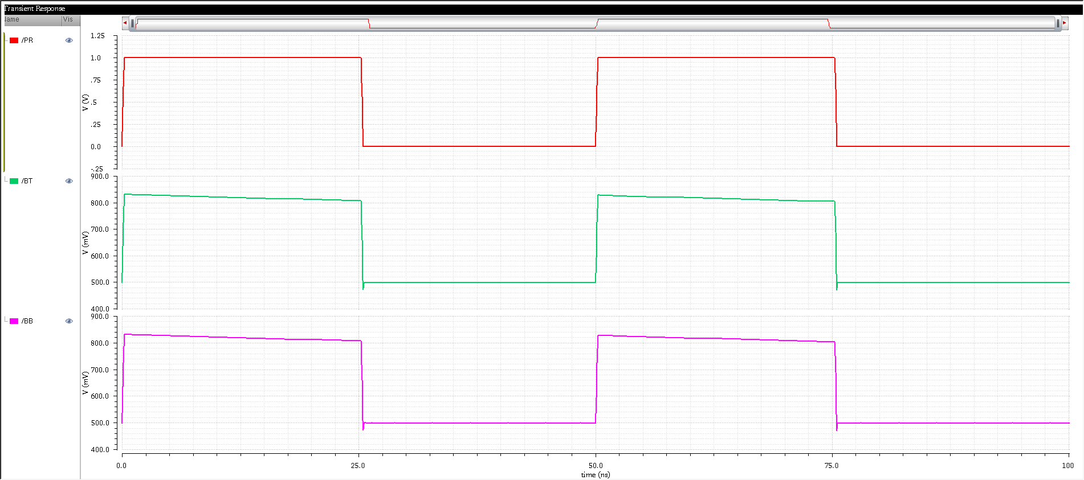
BANGALORE INSTITUTE OF TECHNOLOGY
Simulation result of Pre-charge
DEPARTMENT OF ELECTRONICS AND COMMUNICATION ENGINEERING

Slide 18
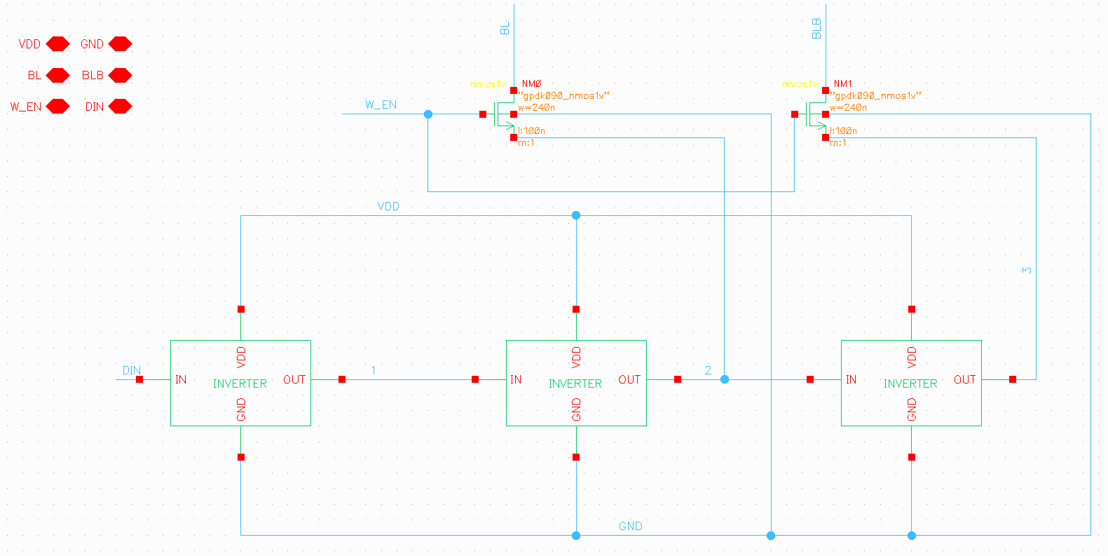
BANGALORE INSTITUTE OF TECHNOLOGY
Design and implementation of Write Driver:
When the write enable signal (WE) is high, the input data (DATA) is written onto the bitlines (BL and BLB) using two pass transistors (NM1 and NM2).
If DATA is high, BL is pulled high and BLB is pulled low, and vice-versa if DATA is low.
This written data is then stored in the corresponding SRAM cell connected to the activated bitlines.
DEPARTMENT OF ELECTRONICS AND COMMUNICATION ENGINEERING

Slide 19
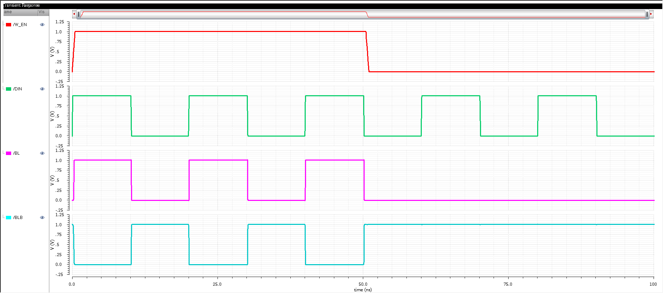
BANGALORE INSTITUTE OF TECHNOLOGY
Simulation result of write driver
DEPARTMENT OF ELECTRONICS AND COMMUNICATION ENGINEERING

Slide 20
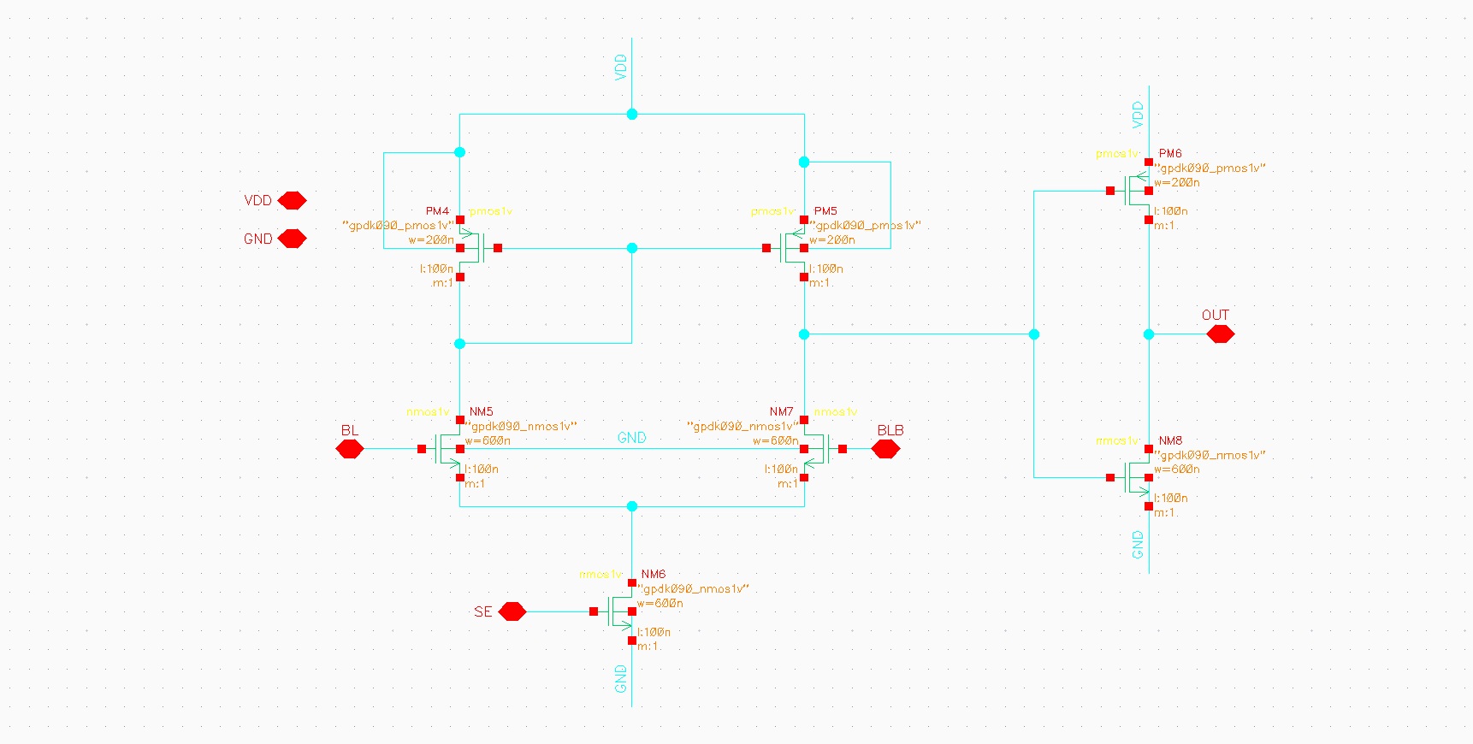
BANGALORE INSTITUTE OF TECHNOLOGY
Schematic Representation of Sense Amplifier:
Sense amplifiers are used in the memories to speed up the read operation.
Sense amplifier takes the small signal difference bit line voltage as input and gives full swing single ended output.
Access time and power consumption of memory is affected by the sense amplifier hence the performance of memory is improved by reducing both sensing delay and power dissipation.
DEPARTMENT OF ELECTRONICS AND COMMUNICATION ENGINEERING

Slide 21
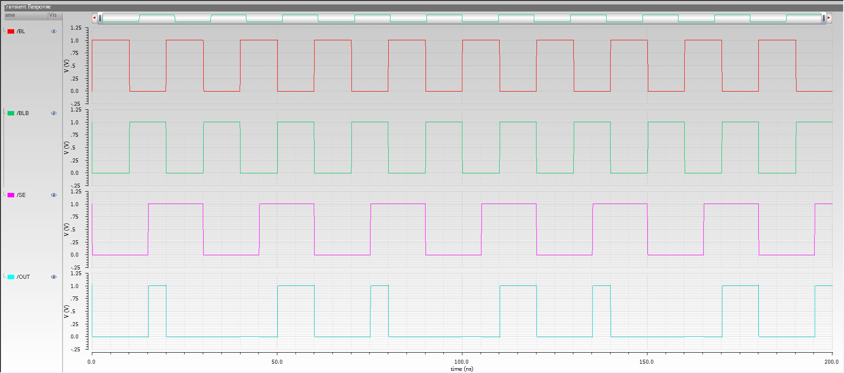
BANGALORE INSTITUTE OF TECHNOLOGY
Simulation result of Sense Amplifier
DEPARTMENT OF ELECTRONICS AND COMMUNICATION ENGINEERING

Slide 22
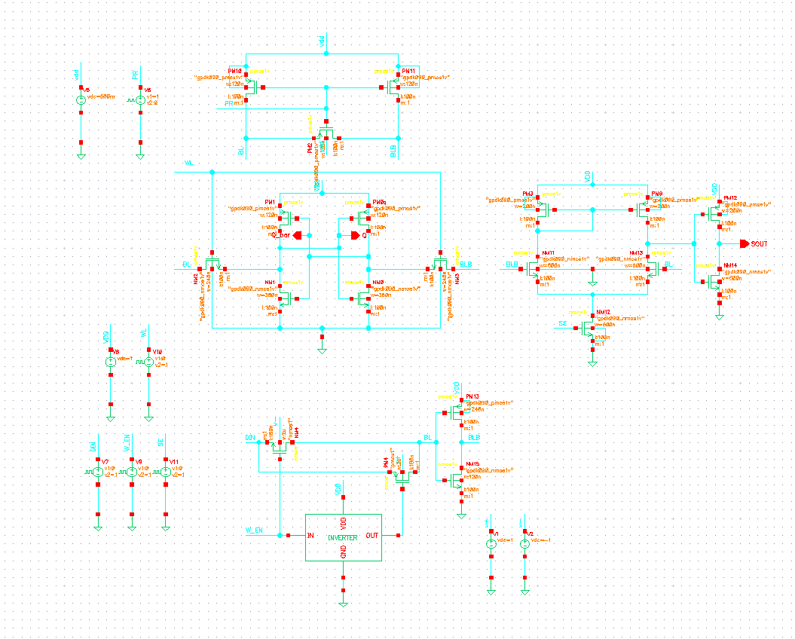
BANGALORE INSTITUTE OF TECHNOLOGY
Design and implementation of 1 bit SRAM cell
The One-Bit 6T SRAM schematic with peripheral components.
The signals used in the simulation results: ‘pre-charge’ from the pre-charge circuit, ‘word-line’ from 6T SRAM circuit, ‘write_en’ corresponds to write enable signal from the write driver circuits, ‘bit-line’ and ‘bit-line bar’ acts as input or output based on write/read operation, ‘q’ and ‘qb’ corresponds to the storage nodes Q and QB of 6T SRAM during write operation.
‘read_en’ corresponds to the read enable signal given to the sense amplifier circuits and ‘out’ signal gives the output of reading operation from sense amplifier circuit.
DEPARTMENT OF ELECTRONICS AND COMMUNICATION ENGINEERING

Slide 23
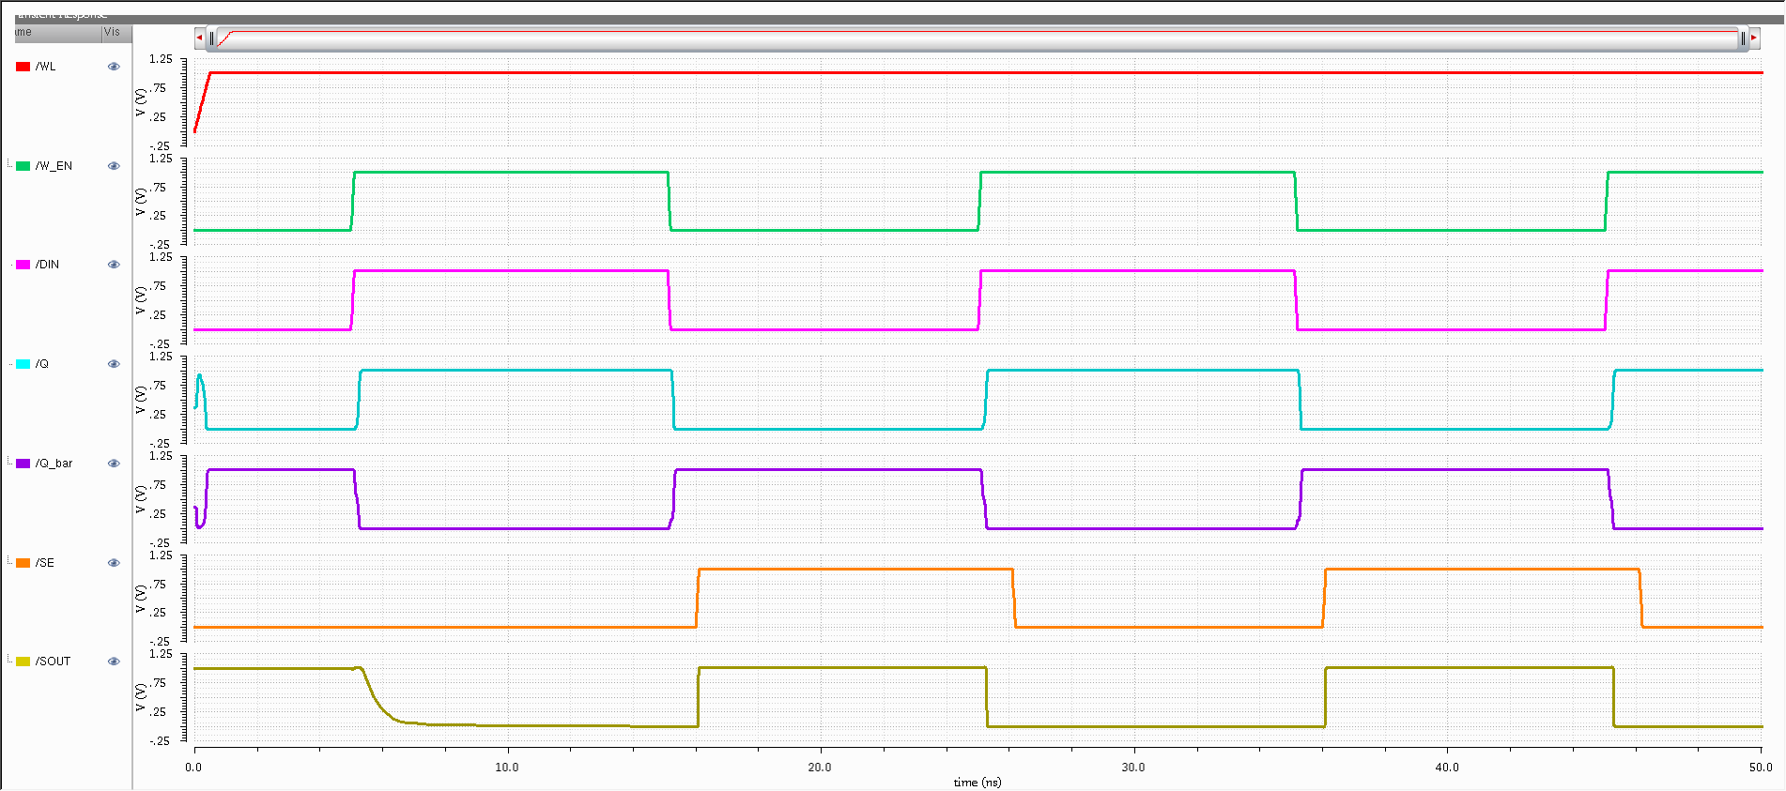
BANGALORE INSTITUTE OF TECHNOLOGY
Simulation result of 1 bit SRAM cell
DEPARTMENT OF ELECTRONICS AND COMMUNICATION ENGINEERING

Slide 24
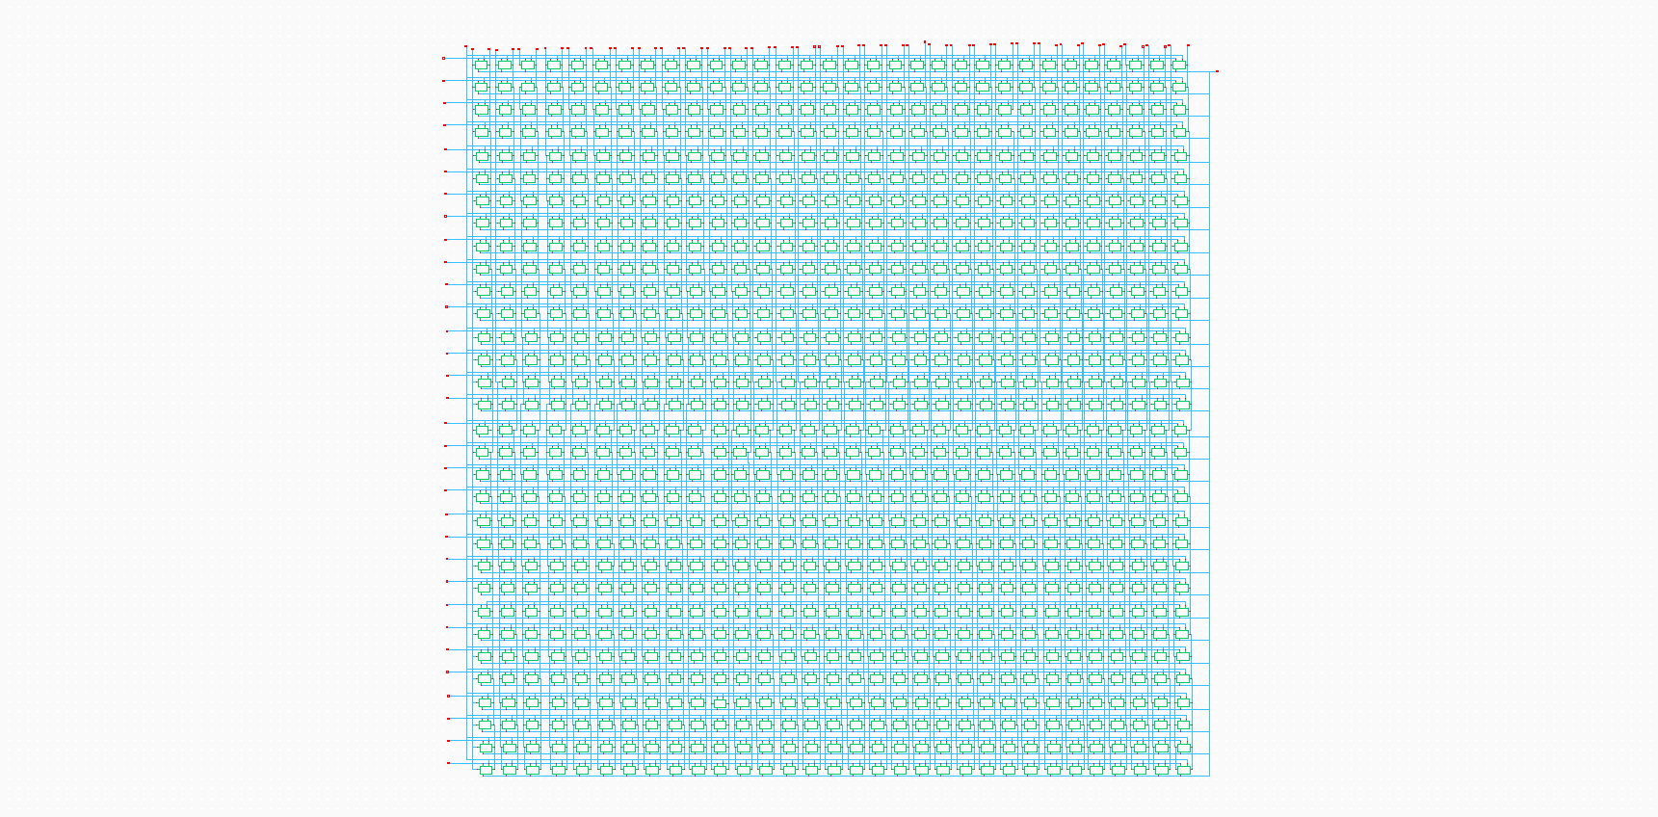
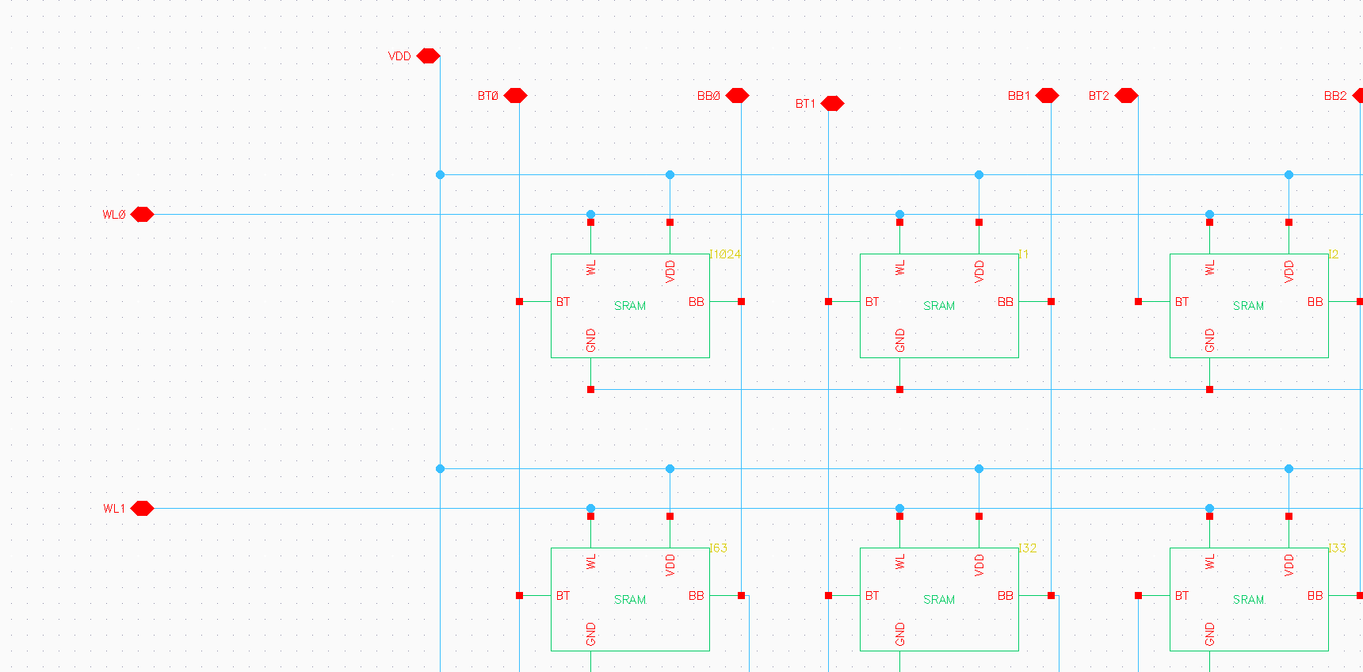

BANGALORE INSTITUTE OF TECHNOLOGY
Design and implementation of Cell Array
The array has a total storage capacity of 1 kilobit (1 Kb), which equates to 1024 bits.
The 32x32 organization allows for easy addressing of individual cells.
Internally, each SRAM cell is typically implemented using a 6-transistor (6T) circuit, which consists of two cross-coupled inverters and two access transistors.
DEPARTMENT OF ELECTRONICS AND COMMUNICATION ENGINEERING

Slide 25
BANGALORE INSTITUTE OF TECHNOLOGY
Design of Row Decoder, Column Decoder and Column MUX
Row decoder, Column Decoder and Column MUX these three components work together to enable efficient and accurate access to the data stored in the SRAM. Without them, it would be difficult to address and retrieve specific data elements from the vast array of memory cells.
Fig: Schematic of 32x32 SRAM cell array
Addressing: The row and column decoders ensure that the correct cell is selected for reading or writing.
Data Transfer: The column MUX ensures that the data from the selected columns is properly routed to the output, enabling the transfer of multiple bits of data in parallel.
DEPARTMENT OF ELECTRONICS AND COMMUNICATION ENGINEERING

Slide 26
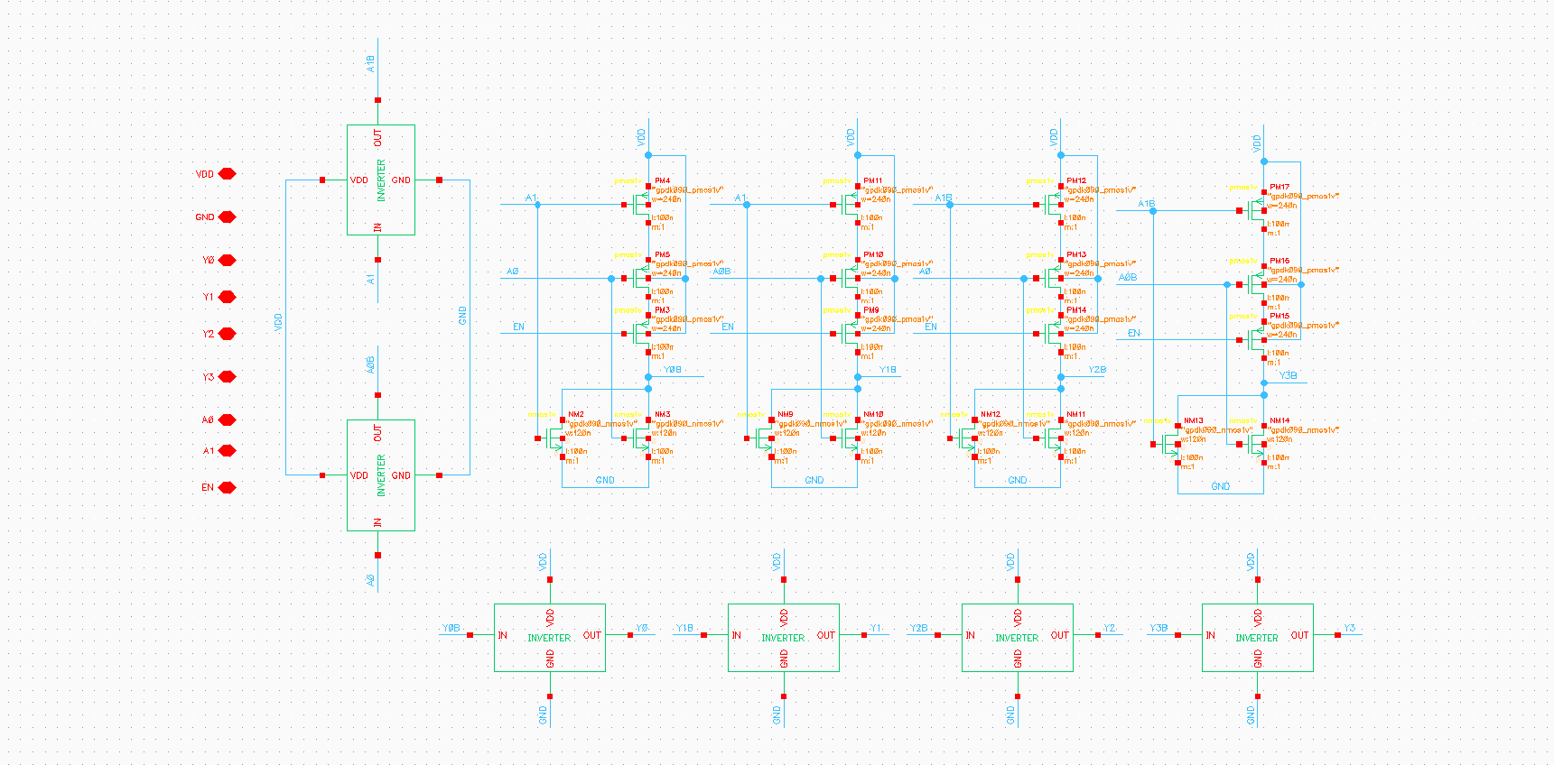
BANGALORE INSTITUTE OF TECHNOLOGY
Row Decoder:
Schematic Representation of 2-4 decoder
The circuit diagram depicts a 2-to-4 decoder using CMOS technology.
It decodes 2 binary inputs into 4 mutually exclusive outputs, activating only one output line corresponding to the input binary code.
DEPARTMENT OF ELECTRONICS AND COMMUNICATION ENGINEERING

Slide 27
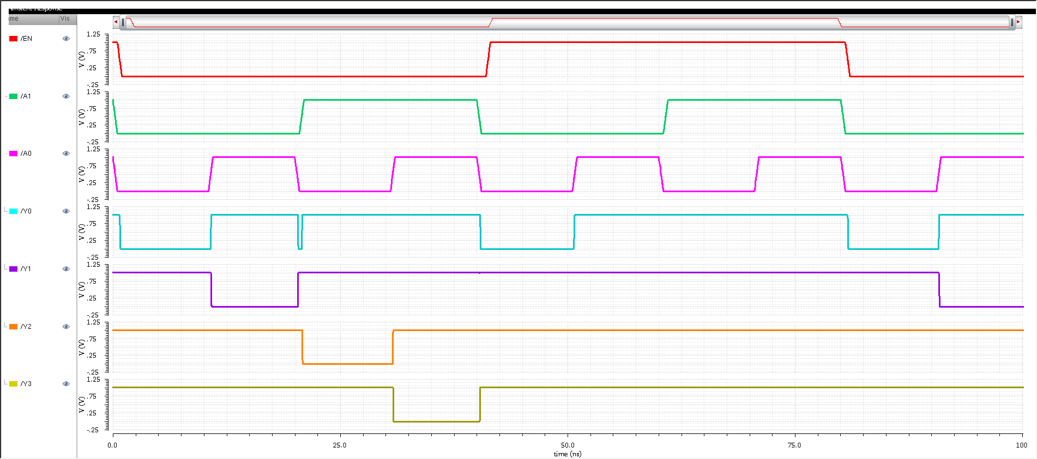
BANGALORE INSTITUTE OF TECHNOLOGY
Simulation result of 2_4 decoder
DEPARTMENT OF ELECTRONICS AND COMMUNICATION ENGINEERING

Slide 28
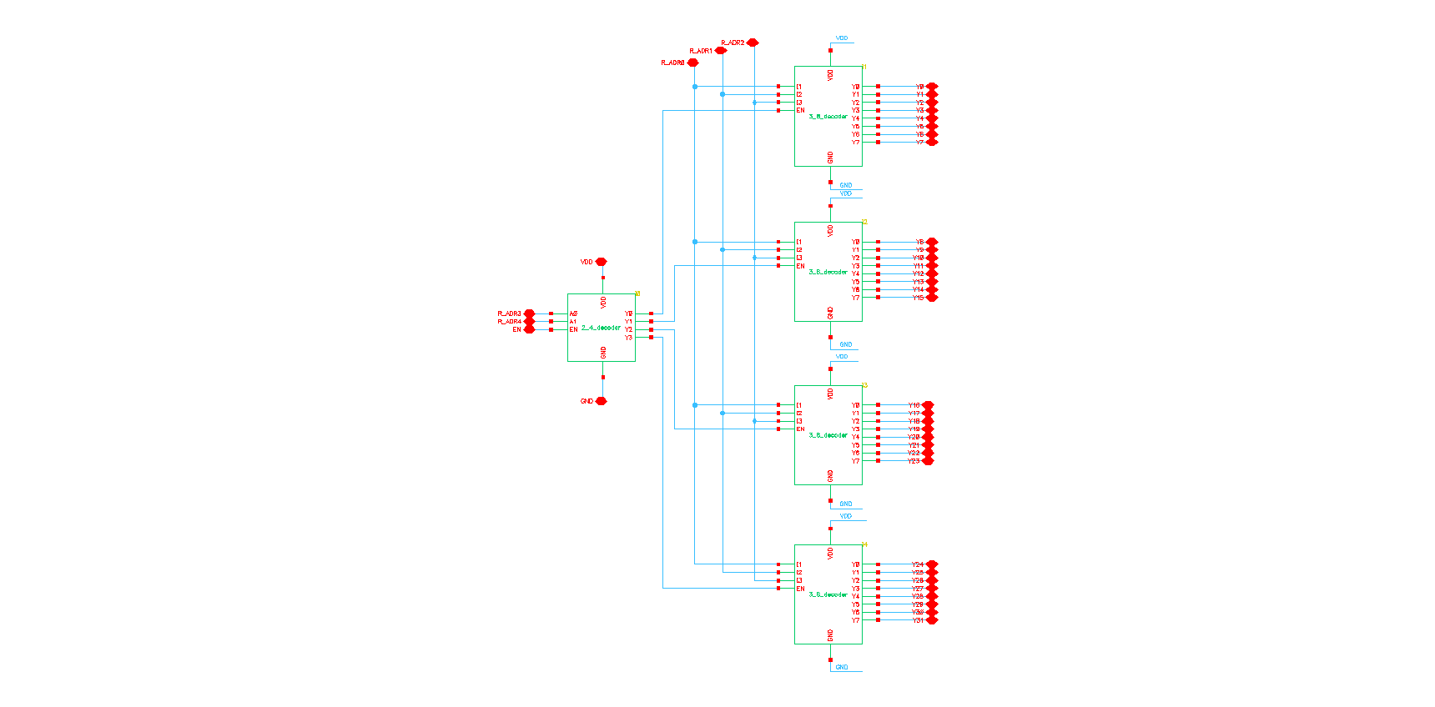
BANGALORE INSTITUTE OF TECHNOLOGY
Design and implementation of Row Decoder:
The circuit diagram illustrates a 5-to-32 decoder constructed using four 3-to-8 decoders and one 2-to-4 decoder.
It takes 5 binary inputs (A0-A4) and produces 32 unique outputs (D0-D31), where only one output line is activated high corresponding to the input binary code.
DEPARTMENT OF ELECTRONICS AND COMMUNICATION ENGINEERING

Slide 29
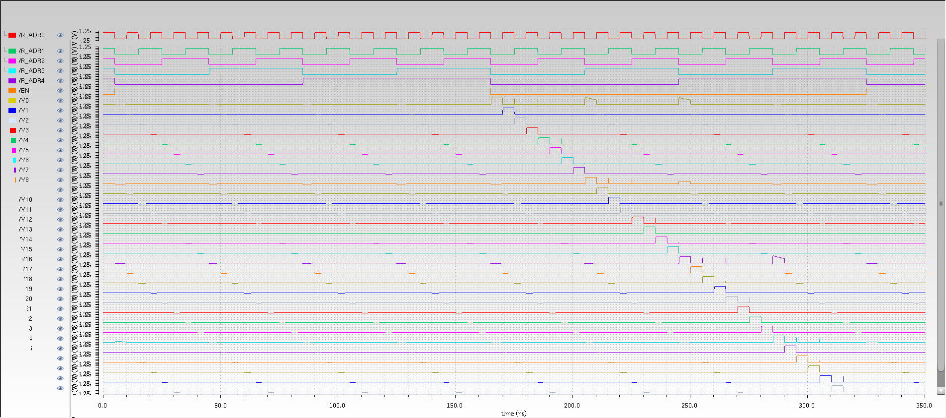
BANGALORE INSTITUTE OF TECHNOLOGY
Simulation result of Row Decoder:
DEPARTMENT OF ELECTRONICS AND COMMUNICATION ENGINEERING

Slide 30
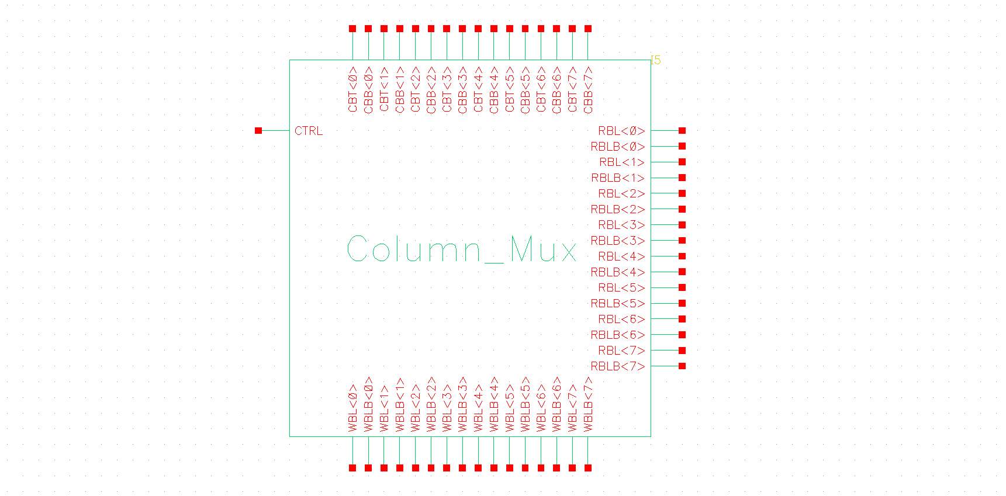
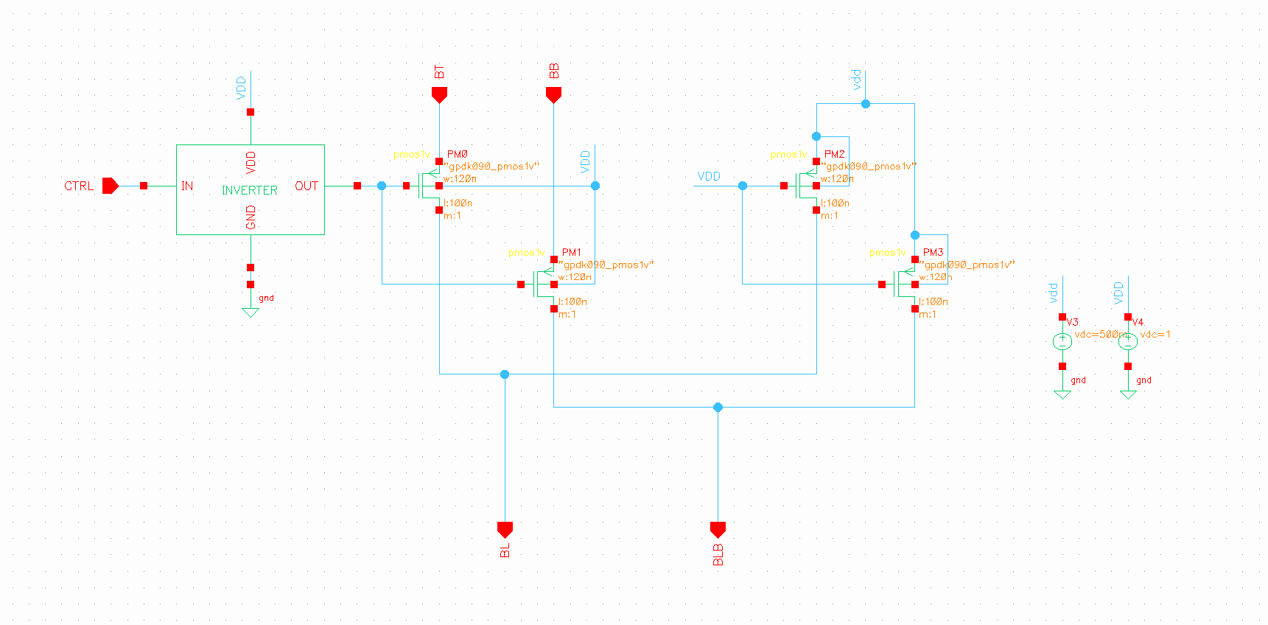
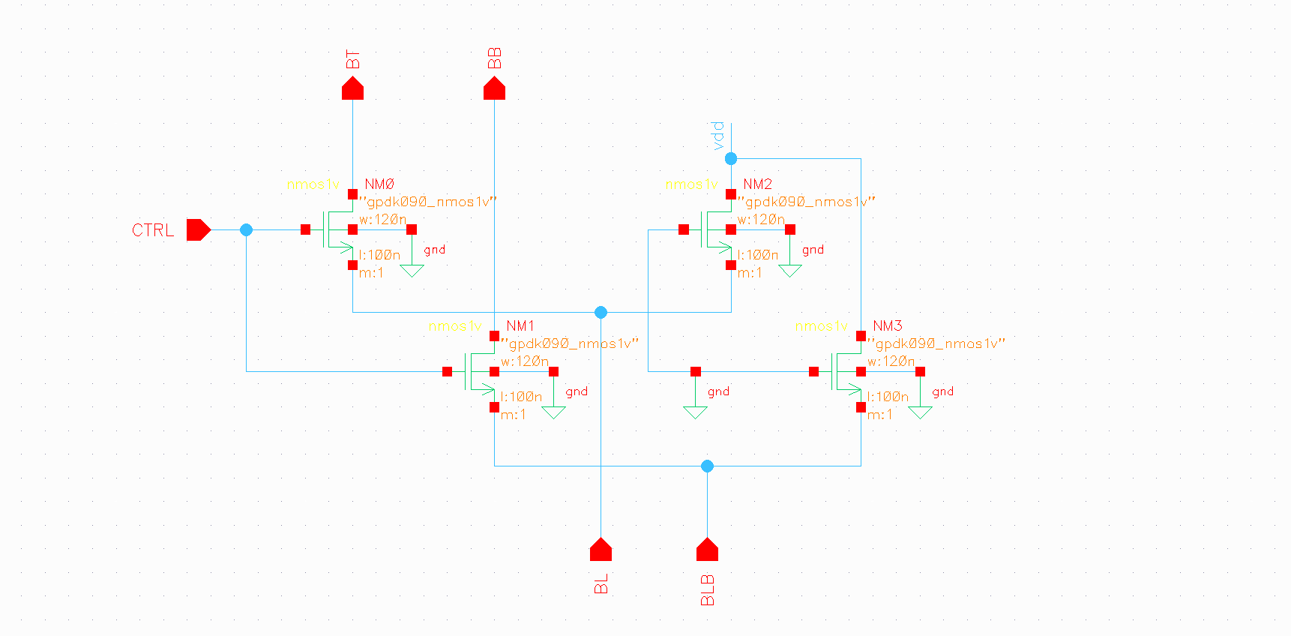
BANGALORE INSTITUTE OF TECHNOLOGY
Designing of Column Mux:
Fig: Column Mux Symbol
Fig: Column Mux schematic for read
Fig: Column Mux schematic for write
This circuit is used to select particular column in the memory array.
The design of 1Kb array, there is totally 32 numbers of SRAM cells present in a cell row and these 32 cells are divided into 4 portions such that the output of SRAM memory is having a size of 8 bits.
DEPARTMENT OF ELECTRONICS AND COMMUNICATION ENGINEERING

Slide 31
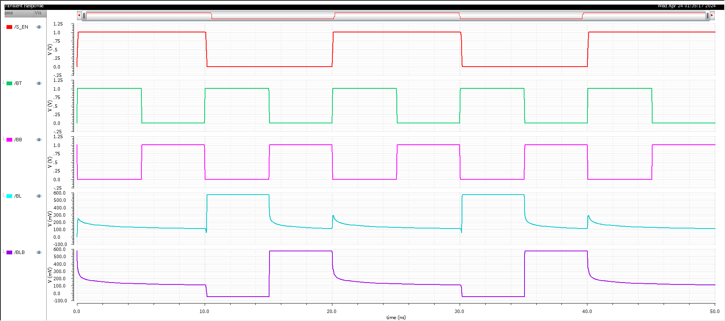
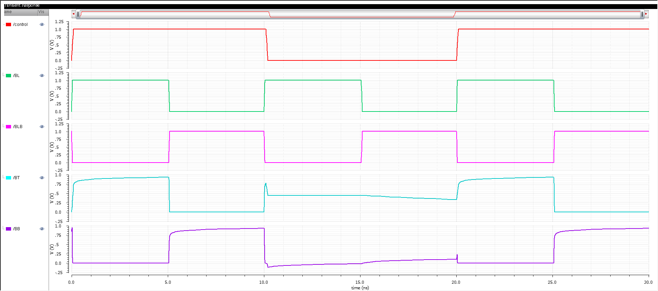
BANGALORE INSTITUTE OF TECHNOLOGY
Simulation result for Read and Write operation of Column Mux:
Fig: Read operation for column mux Fig: Write operation for column mux
DEPARTMENT OF ELECTRONICS AND COMMUNICATION ENGINEERING

Slide 32
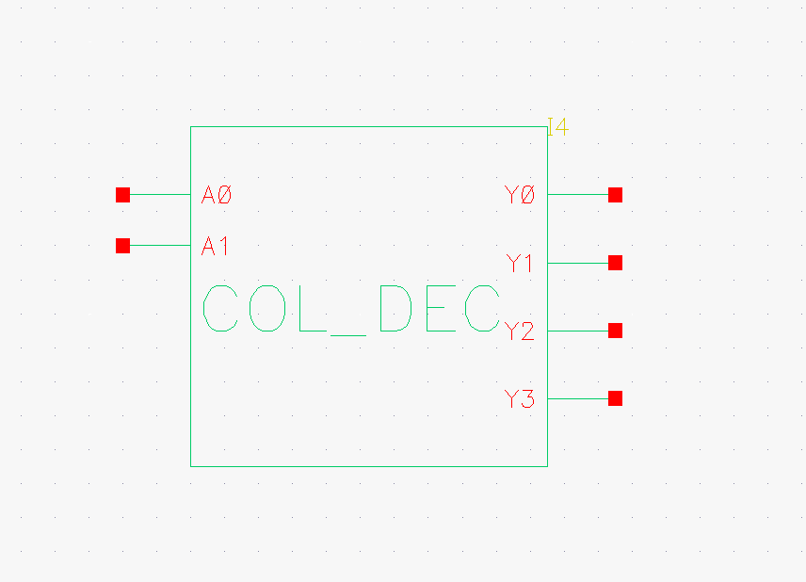
BANGALORE INSTITUTE OF TECHNOLOGY
Schematic Representation of Column Decoder
The column decoder is responsible for selecting a specific column mux of the SRAM array based on the address provided.
It takes a binary address input and decodes it into a set of control signals, each of which corresponds to a particular column of an array.
DEPARTMENT OF ELECTRONICS AND COMMUNICATION ENGINEERING

Slide 33
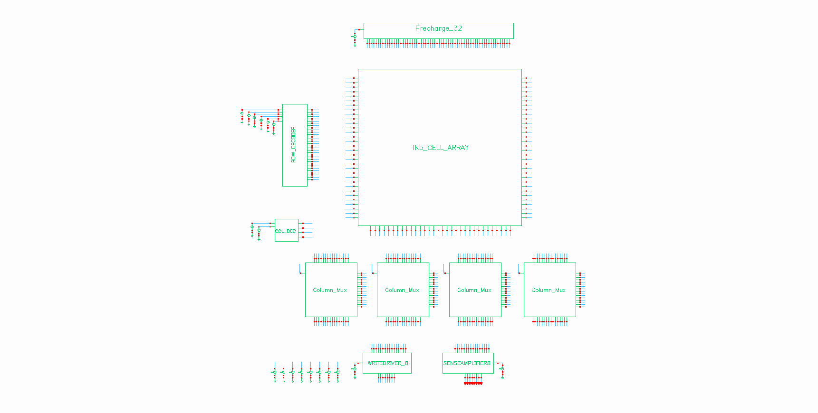
BANGALORE INSTITUTE OF TECHNOLOGY
Design and implementation of 1kb SRAM memory
Figure shows the complete schematic of 1kb SRAM cell with its peripheral circuits.
1kb SRAM memory have the aspect ratio of 32*32.
DEPARTMENT OF ELECTRONICS AND COMMUNICATION ENGINEERING

Slide 34
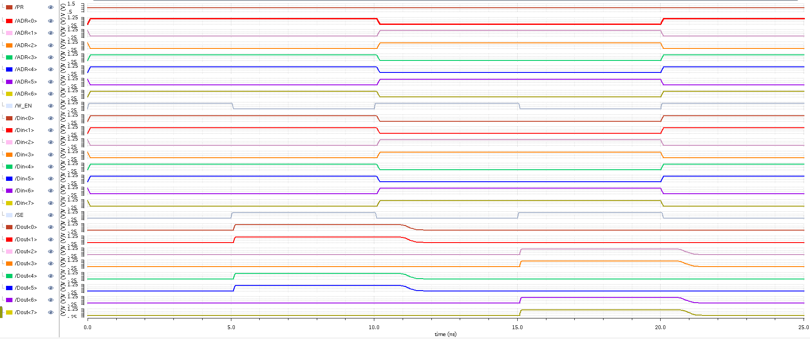
BANGALORE INSTITUTE OF TECHNOLOGY
Simulation results of 1kb SRAM memory
DEPARTMENT OF ELECTRONICS AND COMMUNICATION ENGINEERING

Slide 35
BANGALORE INSTITUTE OF TECHNOLOGY
OBSERVATIONS AND RESULTS
Table 1: Comparison of Delays
Delay | Proposed Design | Ref [5] | Ref [7]
Read delay (ps) | 29.4 | 267.3 | 170
Write delay (ps) | 15 | 156.3 | 180
DEPARTMENT OF ELECTRONICS AND COMMUNICATION ENGINEERING

Slide 36
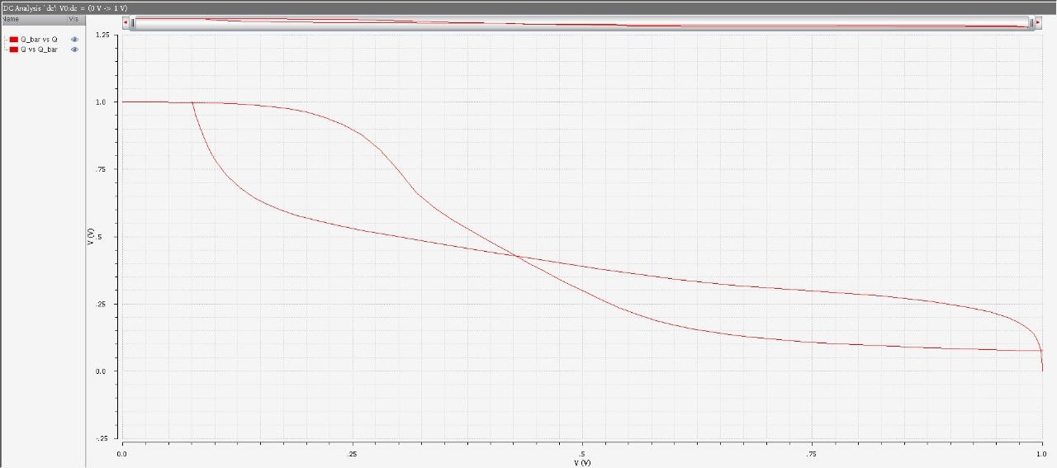
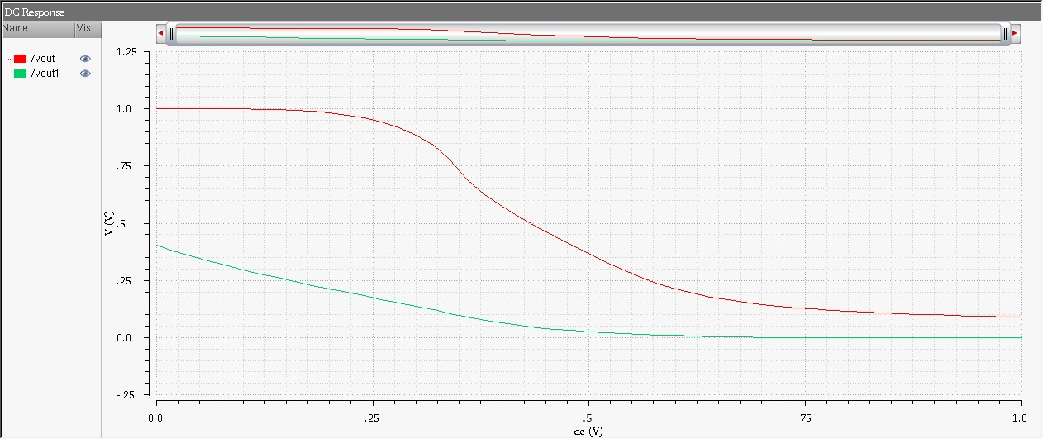
BANGALORE INSTITUTE OF TECHNOLOGY
Analysis of Butterfly curve for read and write operation
Fig: Read operation curve Fig: Write operation curve
DEPARTMENT OF ELECTRONICS AND COMMUNICATION ENGINEERING

Slide 37
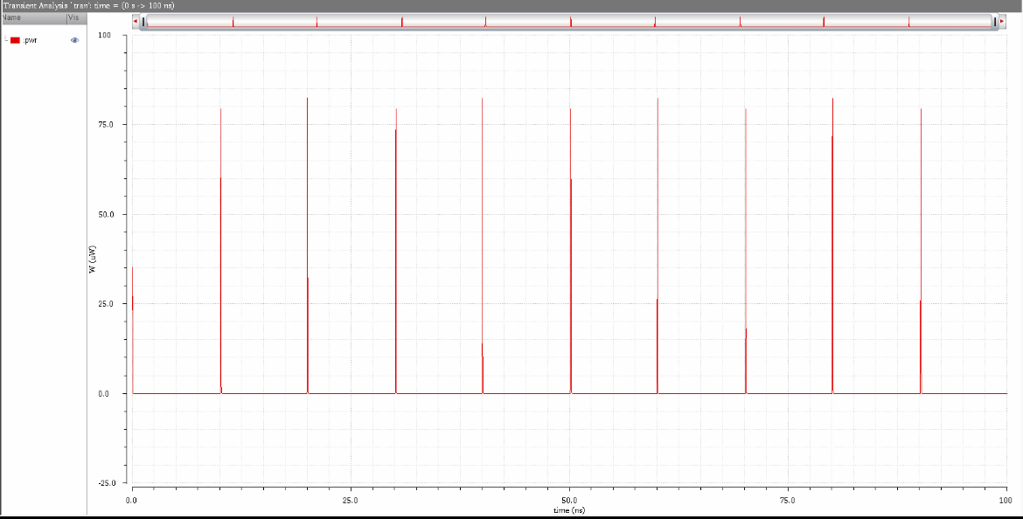
BANGALORE INSTITUTE OF TECHNOLOGY
Power analysis of 6T SRAM cell
Fig: Power Analysis Graph
Dynamic Power: This is the dominant power consumption during read and write operations. It occurs when transistors in the SRAM cell switch states.
Static Power: This is the leakage current that flows even when the SRAM is not actively reading or writing data. It's a continuous power drain.
DEPARTMENT OF ELECTRONICS AND COMMUNICATION ENGINEERING

Slide 38
BANGALORE INSTITUTE OF TECHNOLOGY
Table 2: RESULTS
Parameters | Values Obtained
Read Delay | 29.4ps
Write Delay | 15ps
Dynamic Power Dissipation | 82.231uW
Static Power Dissipation | 36.617nW
Write SNM | 195mV
Read SNM | 70mV
DEPARTMENT OF ELECTRONICS AND COMMUNICATION ENGINEERING

Slide 39
BANGALORE INSTITUTE OF TECHNOLOGY
CONCLUSION AND FUTURE WORK
The performance analysis of 1kb Static Random-Access Memory is done in this proposed work using 1 bit 6T SRAM.
All the simulations were carried out utilizing cadence virtuoso tool using 90nm CMOS technology. The future works that can be conducted for manufacturing of 2kb ,1MB chip using designed 1-kb block. For that 1MB memory need to design using 1-kb block so that operating frequency will be near to 1kb design.
Attention to high speed is given and the utilization of 90nm CMOS technology posed unique challenges and opportunities, requiring a meticulous approach to transistor sizes, interconnect delays.
The project also involved analysis of delay to ensure the memory array operates within specified speed requirements.
DEPARTMENT OF ELECTRONICS AND COMMUNICATION ENGINEERING

Slide 40
BANGALORE INSTITUTE OF TECHNOLOGY
REFERENCES
[1] “Ultra Low Power SRAM Cell for High Speed Application using 90nm CMOS Technology” proposed by Hansraj, Ajay Rana , 2021.
[2] T. Wada, S. Rajan, and S. Przybylski, “An analytical access time model for on-chip cache memories,” IEEE J. Solid State Circuits, vol. 27, no. 8, pp. 1147–1156, Aug. 2022
[3] “Static Noise Margin Analysis of SRAM Cell For High Speed Application”, Debasis Mukherjee, Hemanta Kr.Mondal
2021 IJCSI.
[4] “Design and analysis of 6T SRAM in 45 nm Technology”, V. Panduranga Vemula, S. Priyanka, A. Sairam , IJERT, 2022.
[5] “Design and Analysis of Area and Power Optimised SRAM Cell for High-speed Processor”, Govind Prasad, Bipin Chandra Mandi, Megha Jain, ICPC2T 2022.
[6] “The Stability Performance Analysis of SRAM Cell Topologies in 90nm and 130nm CMOS technology”, Ajjay Gaadhe, Ujwal Shirode, Rajendra Kanphade, ESCI 2021.
[7] “ Design and Analysis of 10T SRAM Cell with Stability Characterizations”, Deepika Sharma, Shilpi Birla, ICAECT, 2023.
DEPARTMENT OF ELECTRONICS AND COMMUNICATION ENGINEERING

Slide 41

THANKING YOU

